Slide 1



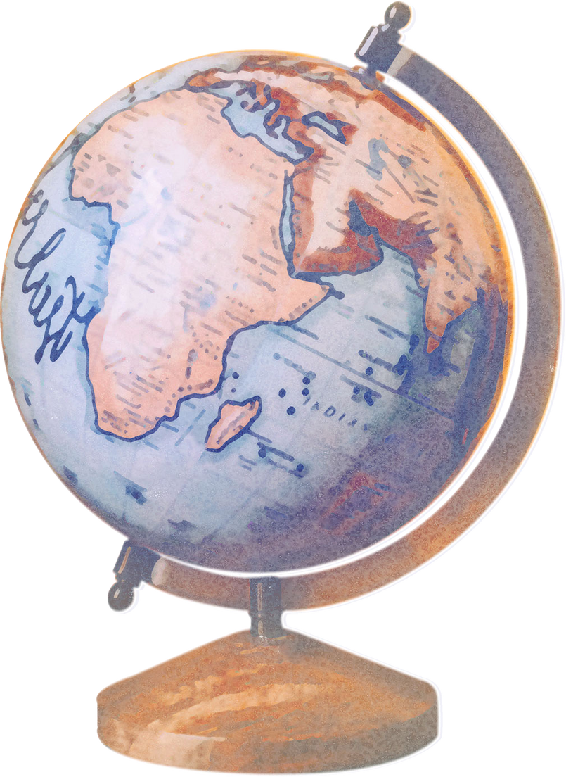
MAHAYANA BUDDHISM
By Group 2

Slide 2





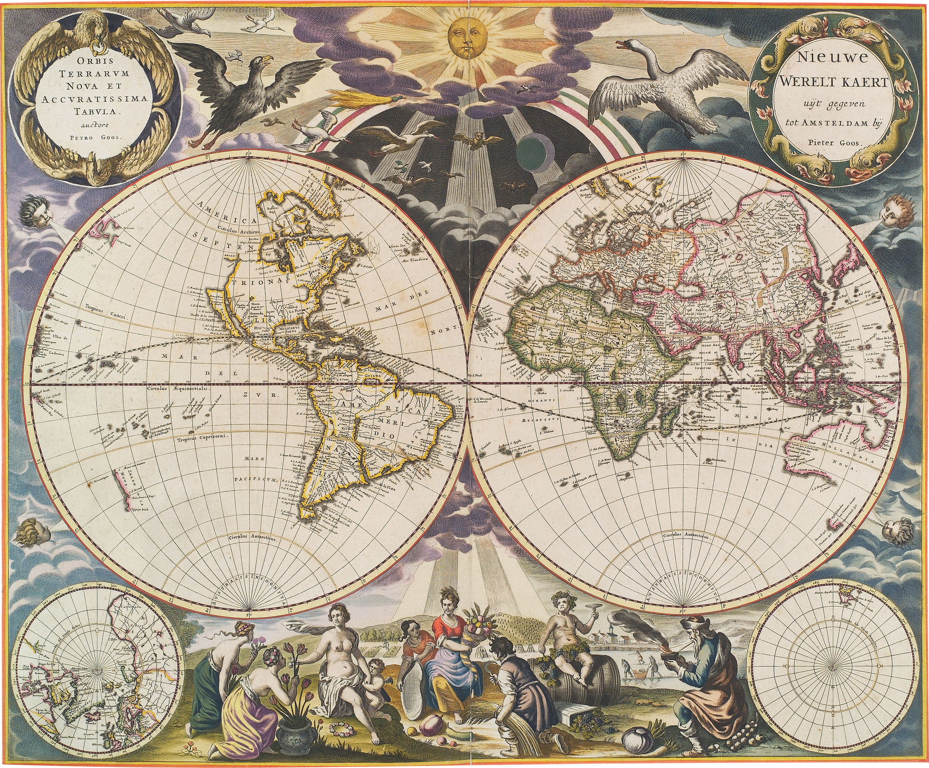
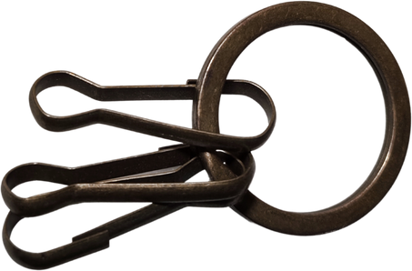


What is Mahayana Buddhism?
Mahayana Buddhism has diverged into
numerous schools with each developing its
own canon and rituals since its founding more than two thousand years ago
Mahayana Buddhism also known
as the "Great Vehicle"

Slide 3
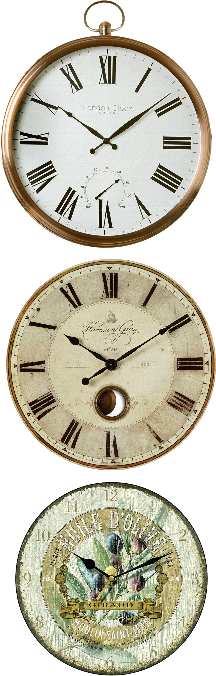

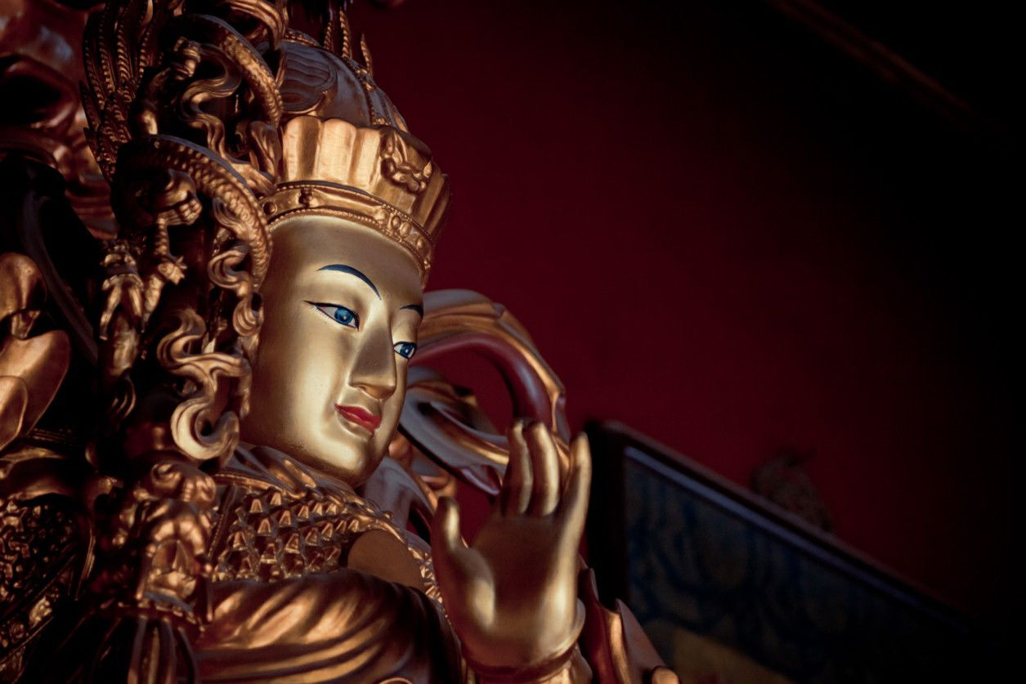
Mahayana Buddhism also known as the "Great Vehicle”

Slide 4
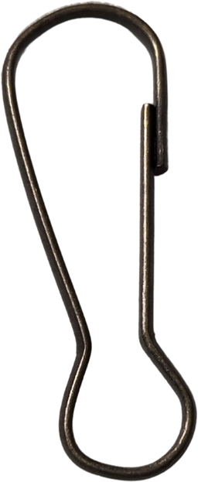
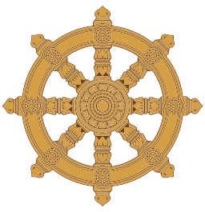

DHARMACHAKRA
The Wheel of the Law (dharmachakra) is the single most important symbol of Buddhism which symbolizes the eight-fold path to Buddhahood

Slide 5
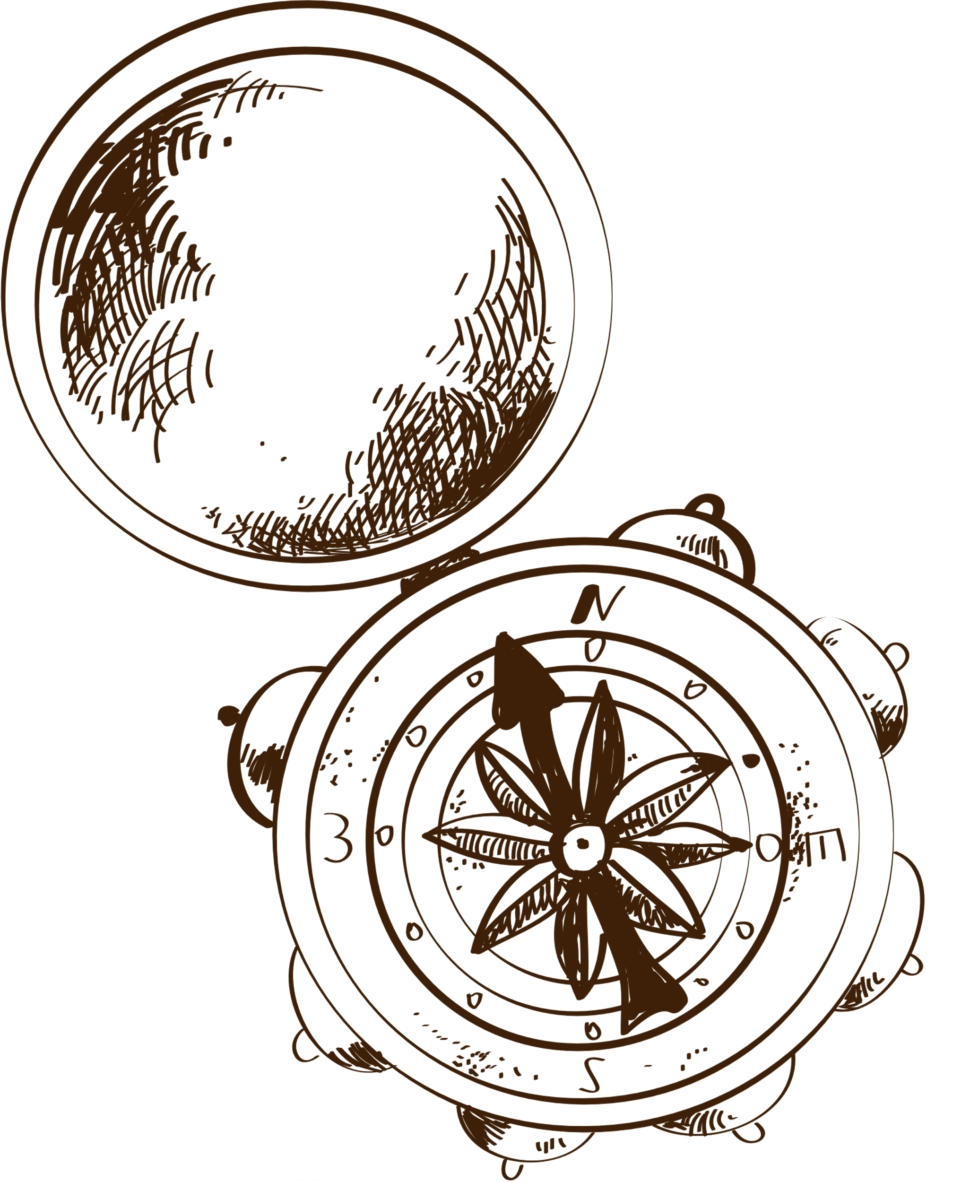
HISTORICAL BACKGROUND
01.
02.
The Mahasamghika ("of the Great Sangha"), one of the early Buddhist schools, may have been the source for the initial growth of Mahayana Buddhism, especially during the
"Second Buddhist Council" that occured a
hundred years after Buddha's parinirvana.
The Mahasamghika ("of Mahayana Buddhists) believed that Siddhartha secretly taught key priciples to chosen people to his most dedicated diciples of, or to the most faithful who could completely interpret these teachings in time (Hopfe 1983; losch 2001).

Slide 6
HISTORICAL BACKGROUND
03.
04
Mahayana buddhists forwarded the
concept that Siddhartha Gautama was
actually a benevolent celestial being, not just a mere human being.
Mahayana Buddhists advanced the radical idea that Siddhartha Gautama was not the only Buddha.

Slide 7

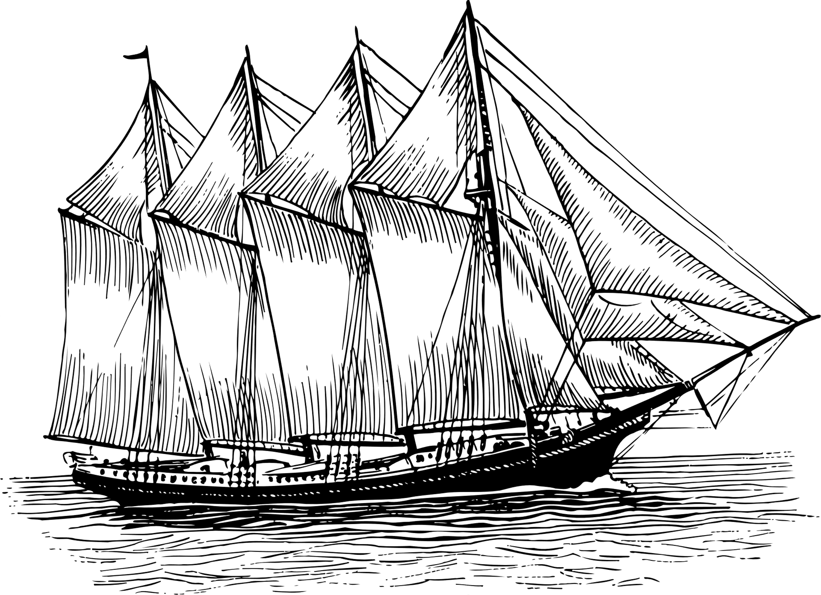
SACRED SCRIPTURE
The canon Mahayana Buddhism consist of Tripitaka namely;
Sutra Pitaka
Abhidharma Pitaka
Vinaya Pitaka
Discourse
Ultimate Doctrine
Discipline
-written collection of Buddha's teachings
-known as Philosophy Basket. It is referred to as a scholastic or philosophical,almost
scientific, description of reality.
-collection of rules given to the community of Buddhist believers.

Slide 8
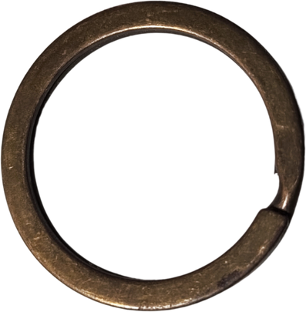
Mahayana Buddhism adapted the Sanskrit usage rather than Pali form of common terms strictly used in Theravada Buddhism.
One of the most popular and prominent Mahayana
Buddhist texts (or Sutra) is the Lotus Sutra, or the
Saddharmapundarika-sutra that literally means
"correct dharma white lotus sutra" or Sutra of the
Lotud of the Wonderful Law" in Sanskrit.

Slide 9
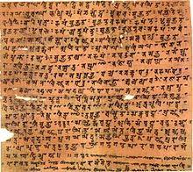
SUTRA
-pertains to one of the
discourses of the historical
buddha that comprise the basic
text of buddhist sacred writing.

Slide 10
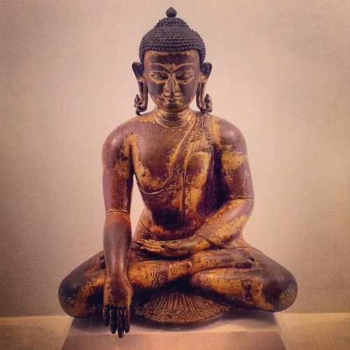
Beliefs and Doctrines
-he died at the age of 80
-born in the fifth or sixth century C.E in present-day Nepal ; is considered as the historical Buddha in Mahayana Buddhism.
-he attined enlightenment at the age of 35;he came back to be known as the Gautama Buddha
Siddhartha Gautama

Slide 11
TRIKAYA
Nirmanakaya
NATURE
The concept of trikaya ("three bodies") pertains to the teaching of Mahayana Buddhism about the nature of the Buddha and reality. While Theravada Buddhism puts very limited emphasis on trikaya, this doctrine is very well-mentioned in Mahayana Buddhism (Jose and Ong, 2016).
Body that manifest the world; embodiment of dharmakaya in human form.
MANIFESTATION
Sambhogakaya
Buddha's earthly body ,just like any other human being's body
Dharmakaya
NATURE
NATURE
Body of absolute
truth; absolute nature
transcendent
of all beings
Body that experiences bliss of enlightenment
MANIFESTATION
MANIFESTATION
Buddha's body of bliss, or enjoyment body
Buddha is transcendent

Slide 12

BODHISATTVAS
4 PRINCIPAL BODHISATTVAS
"enlightened existence"
personification of perfect compassion
AVALOKITESHVARA
-embodiment of great compassion
-the belief that the attainment of Nirvana is not confined to one's self as an arhat ("the perfect one") but must be shared to all striving beings.
embodiment of wisdom, intelligence and willpower
manjushri
one who helps and liberates all sentient beings residing in hell
KSITIGARBHA
representation of love, virtue, and intelligence
SAMANTHABHADRA

Slide 13
BHUMIS and PARAMITAS
on the Mahayana tradition, a bodhisattva must pass 10 BHUMIS ("grounds" of "land") before attaining the so-called "Buddha-hood".
BHUMIS are associated with the PARAMITAS ("perfections") that is translated to as "to cross over the other shore", paramitas imply crossing from the "sea of suffering" to the "shore of happiness".

Slide 14
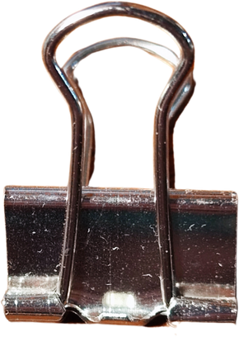
Conclusions

Slide 15
Thank
you!

