Slide 1

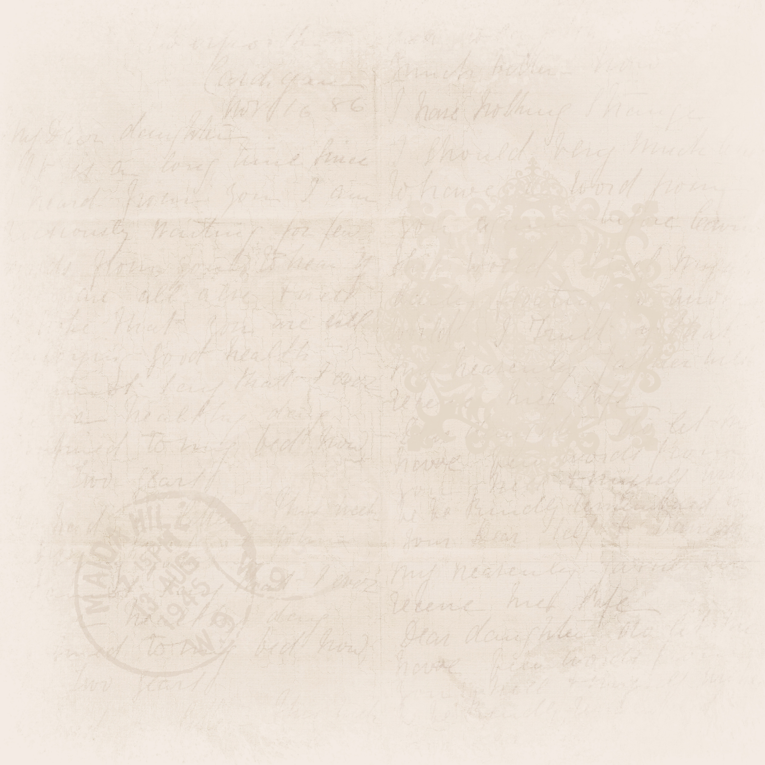



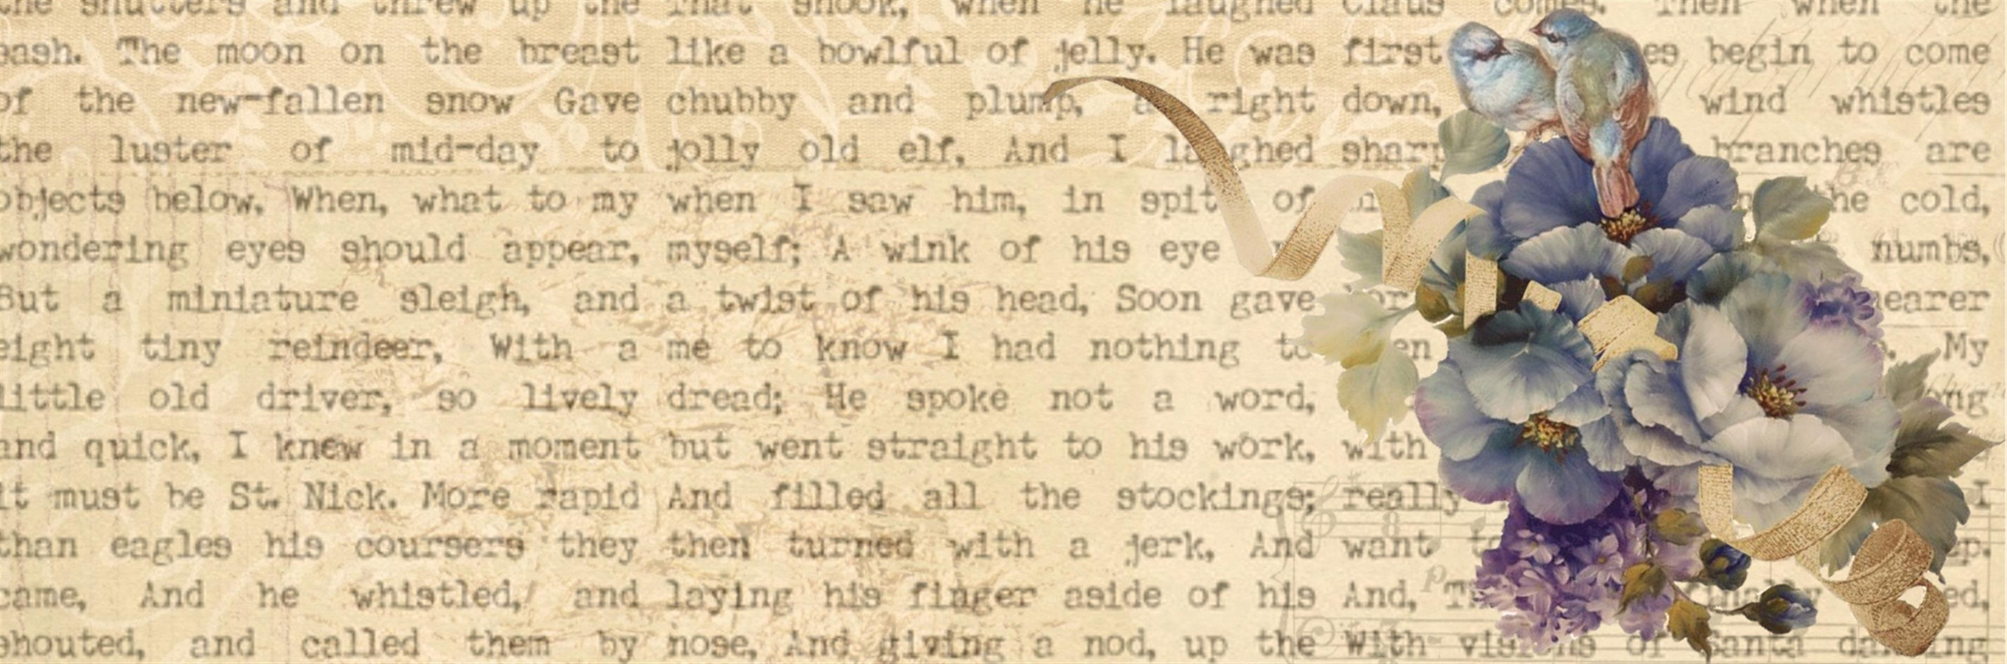
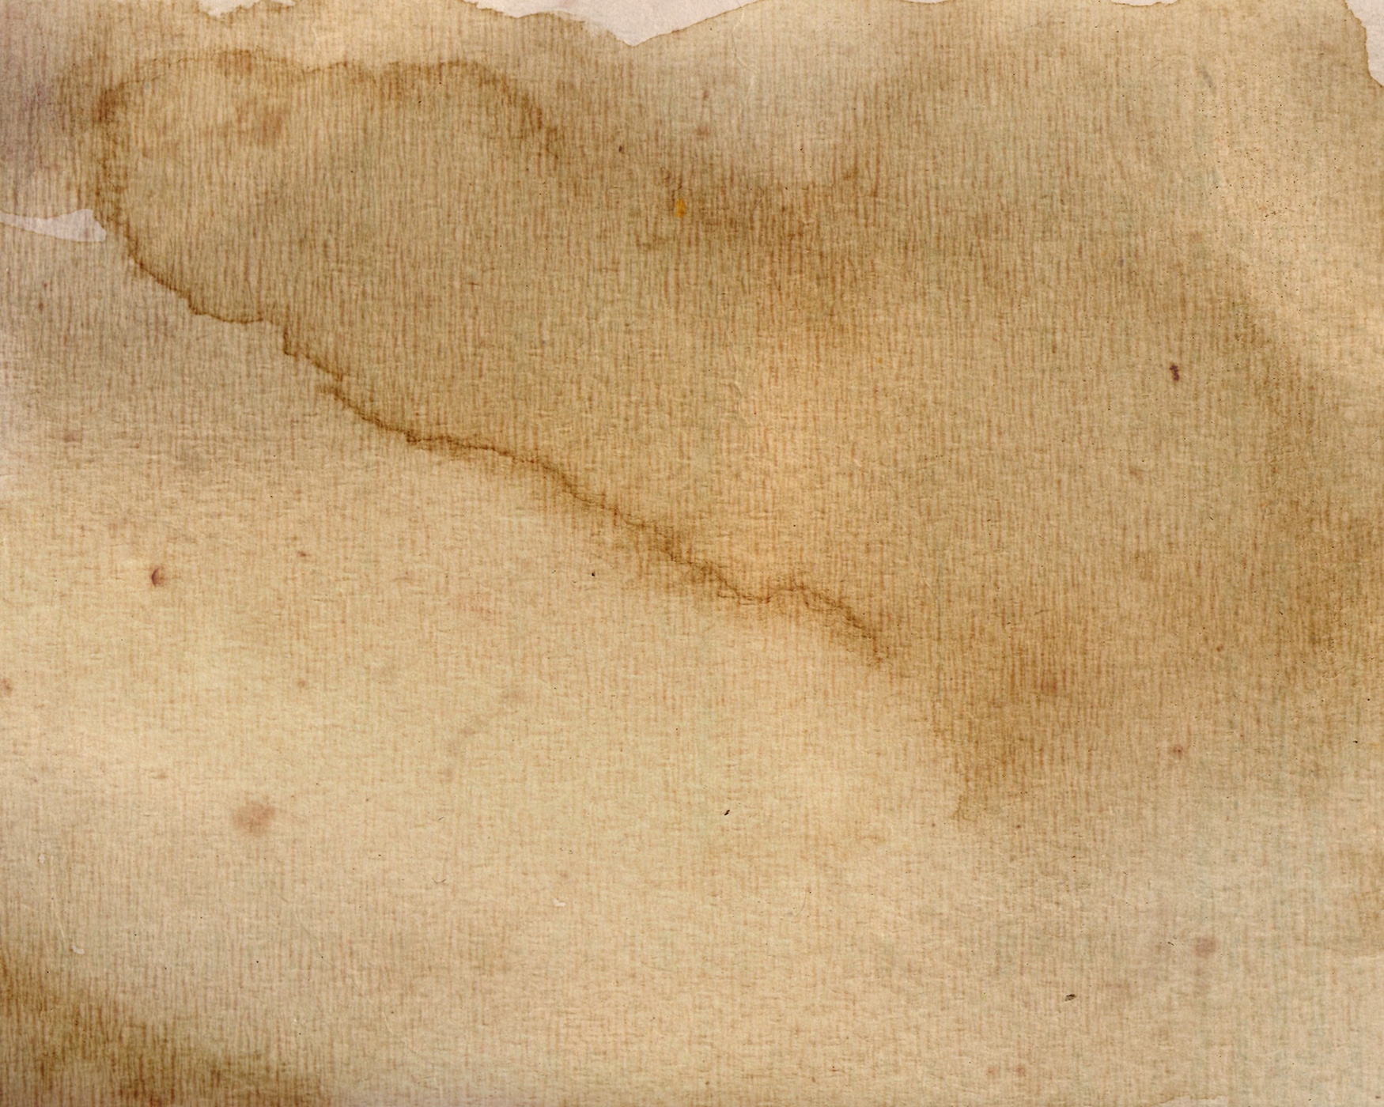


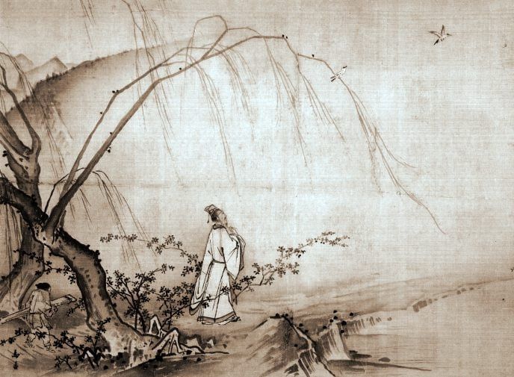

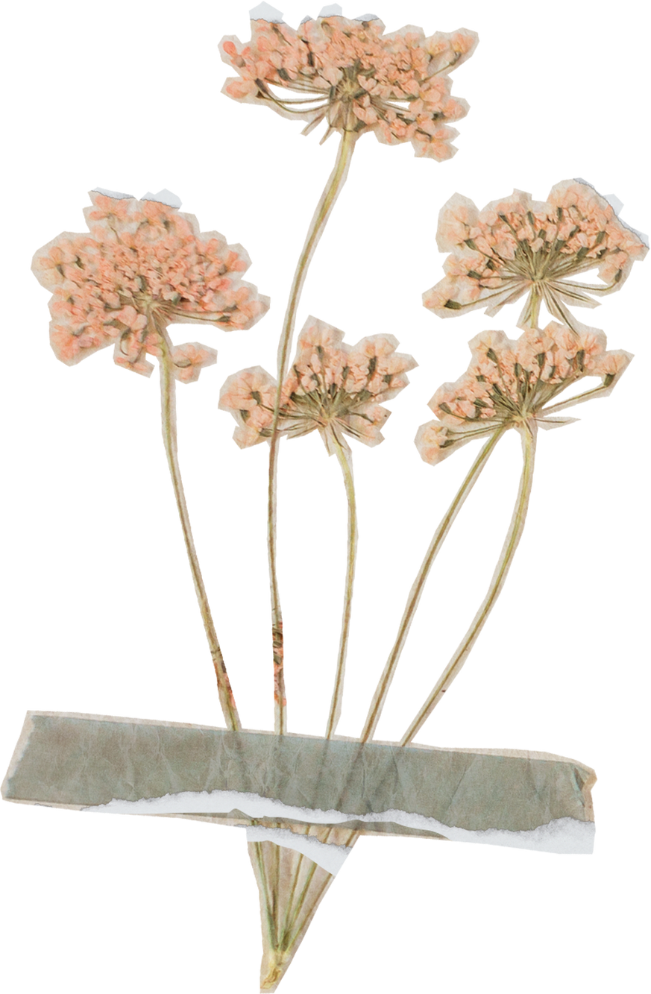

TAOISM
ˈtaʊ. ɪzəm

Slide 2
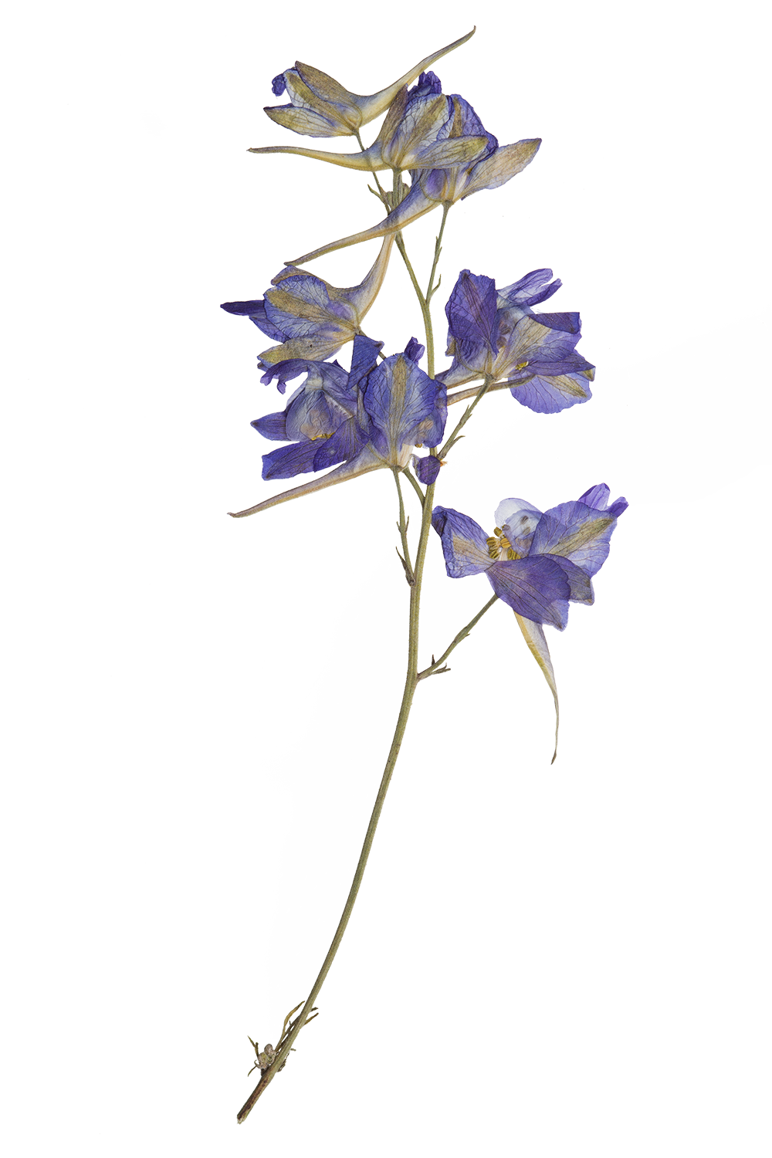

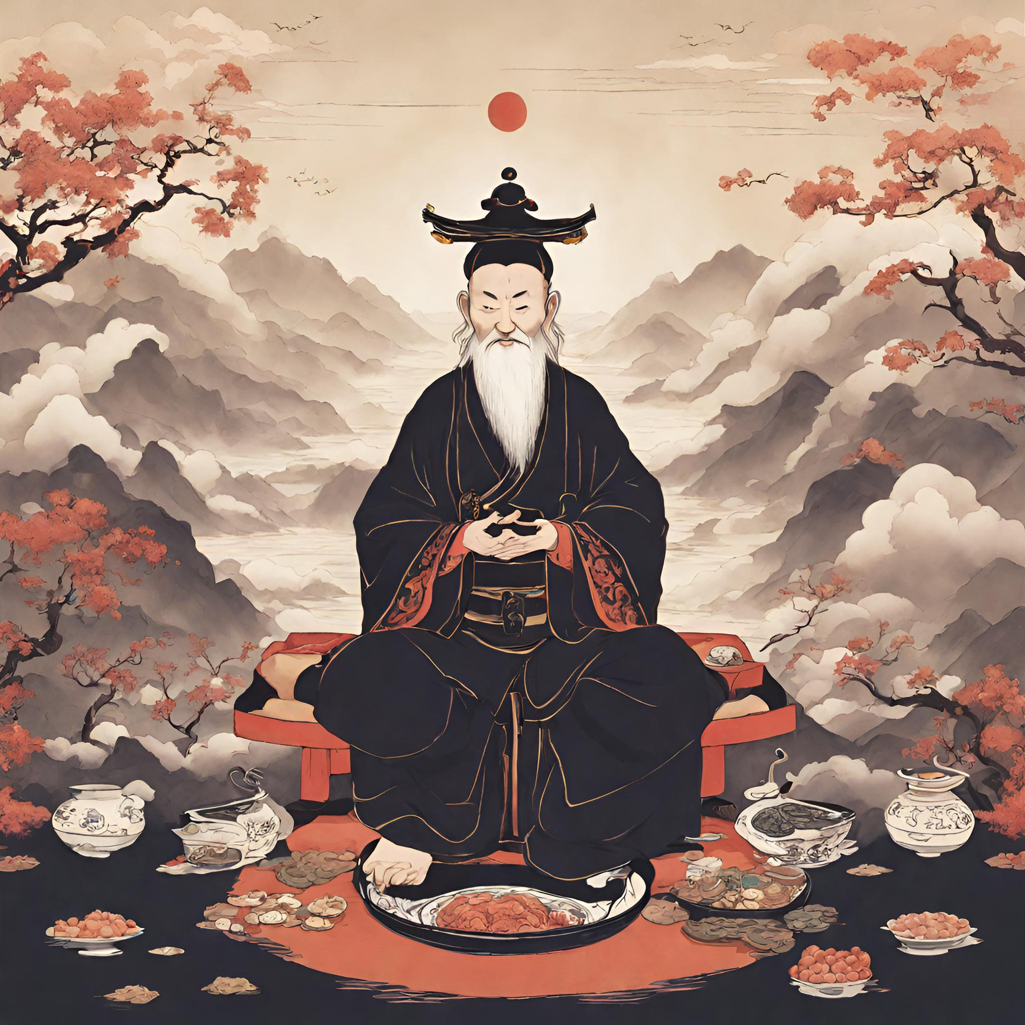
Taoism (also known as Daoism) is a religion and a philosophy from ancient China that has influenced folk and national belief. Taoism has been connected to the philosopher Lao Tzu, who around 500 B.C.E. wrote the main book of Taoism, the Tao Te Ching. Taoism holds that humans and animals should live in balance with the Tao, or the universe. Taoists believe in spiritual immortality, where the spirit of the body joins th universe after death.
INTRODUCTION

Slide 3

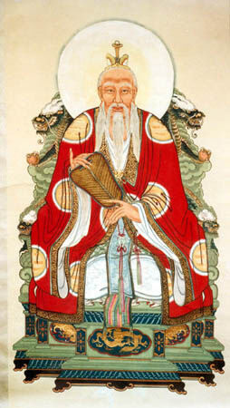
Lao-Tzu ( 604 BCE, also known as Laozi or Lao-Tze) was a Chinese philosopher credited with founding the philosophical system of Taoism. He is best known as the author of the Laozi Tao-Te-Ching taoism most scared text translated as “The Way of Virtue” or “The Classic of the Way and Virtue”) the work which exemplifies his thought.
The name by which he is known is not a personal name but an honorific title meaning 'Old Man' or 'Old Master' and Lao Tzue is considered a deity in religious Taoism and some other ancient Chinese religions. Though his alleged writings are well-preserved many aspects of his life remain shrouded in mystery. His main beliefs emphasize simplicity, humility, and harmony with the natural way of life.
FOUNDER

Slide 4
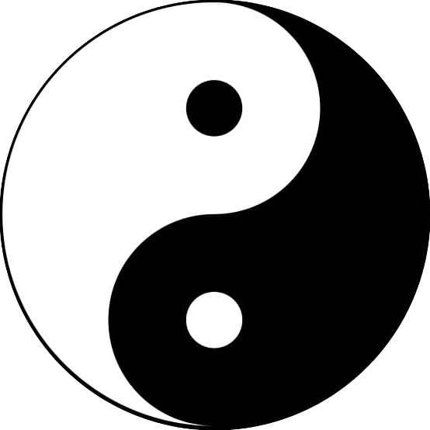
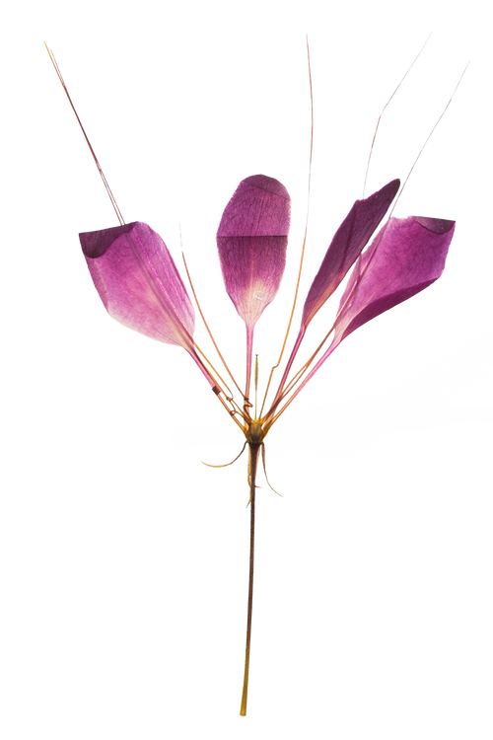
SYMBOL
The Yin and Yang is the most well-known Taoist religious symbol. It is an image composed of a circle divided into two swirling parts: one black and the other white. Within each swirling or teardrop-shaped half is a smaller circle of the opposite color. Overall, the Yin and Yang symbol signifies the perfect harmonic balance in the universe. For example, day and night; birth and death.
According to Taoist cosmology, the big circle signifies the Tao (Dao), the source of existence. Meanwhile, the black and white teardrop-shaped halves signify the Yin-qi and Yang-qi, known as the primordial feminine and mascu line energies, respectively. Taoists believe that the interplay of the Yin-qi and Yang-qi created the manifest world.

Slide 5
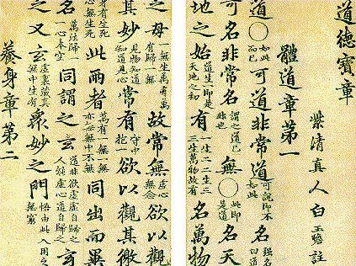
SACRED TEXTS

Slide 6
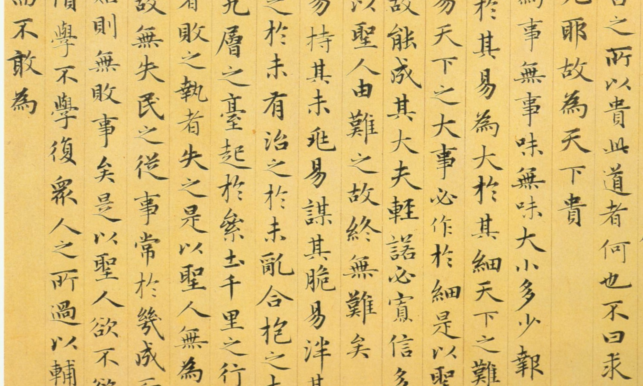
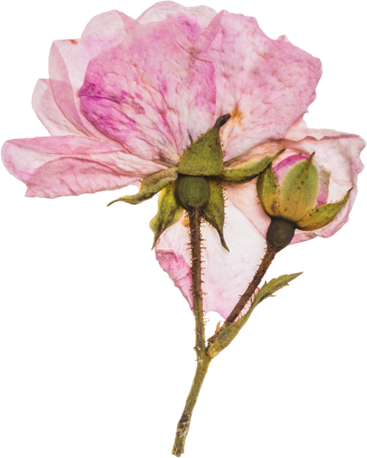
Tao Te Ching
The Tao Te Ching, also known as Dao De Jing, is a mysterious collection of enigmatic remarks that are difficult to understand. Its opening line, "The name that can be named is not the eternal name," suggests the difficulty of putting the truth into words and can only be explained through riddles and paradox. The Tao Te Jing is often attributed to Laozi, but some believe it was a product of collective efforts among various groups in China. It explains the meaning of Tao and its concept of Te, the power or virtue acquired by living in harmony with Tao. The scripture has a paradoxical element, containing contradictory and illogical assertions, yet contains deeper meaning that can be understood through intuition rather than rational thinking.

Slide 7
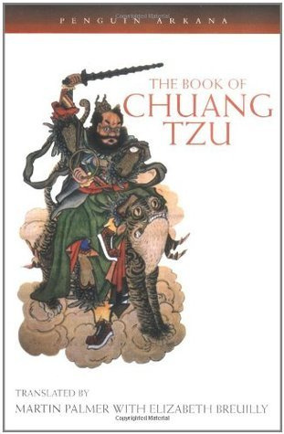
The Book of Chuang-tzu
Another significant book is the Chuang-tzu. This was published after the Tao Te Ching, its compilation began earlier. Like the Tao Te Ching, although it is accredited to a man named Chuang Tzu (Zhuangzi), it is a collection of the wisdom of many different people.
The thinking that led to the Tao Te Ching was probably inclined by an older book called the Nei yeh. This includes early writings on some key Taoist ideas, particularly chi, although some of the ideas differ from their later Taoist form.

Slide 8
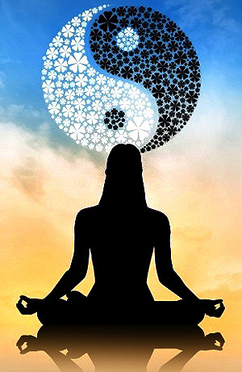
BELIEFS/DOCTRINES
The Dao or Tao
The De
Wu-wei
Yin Yang
Qi/Chi

Slide 9

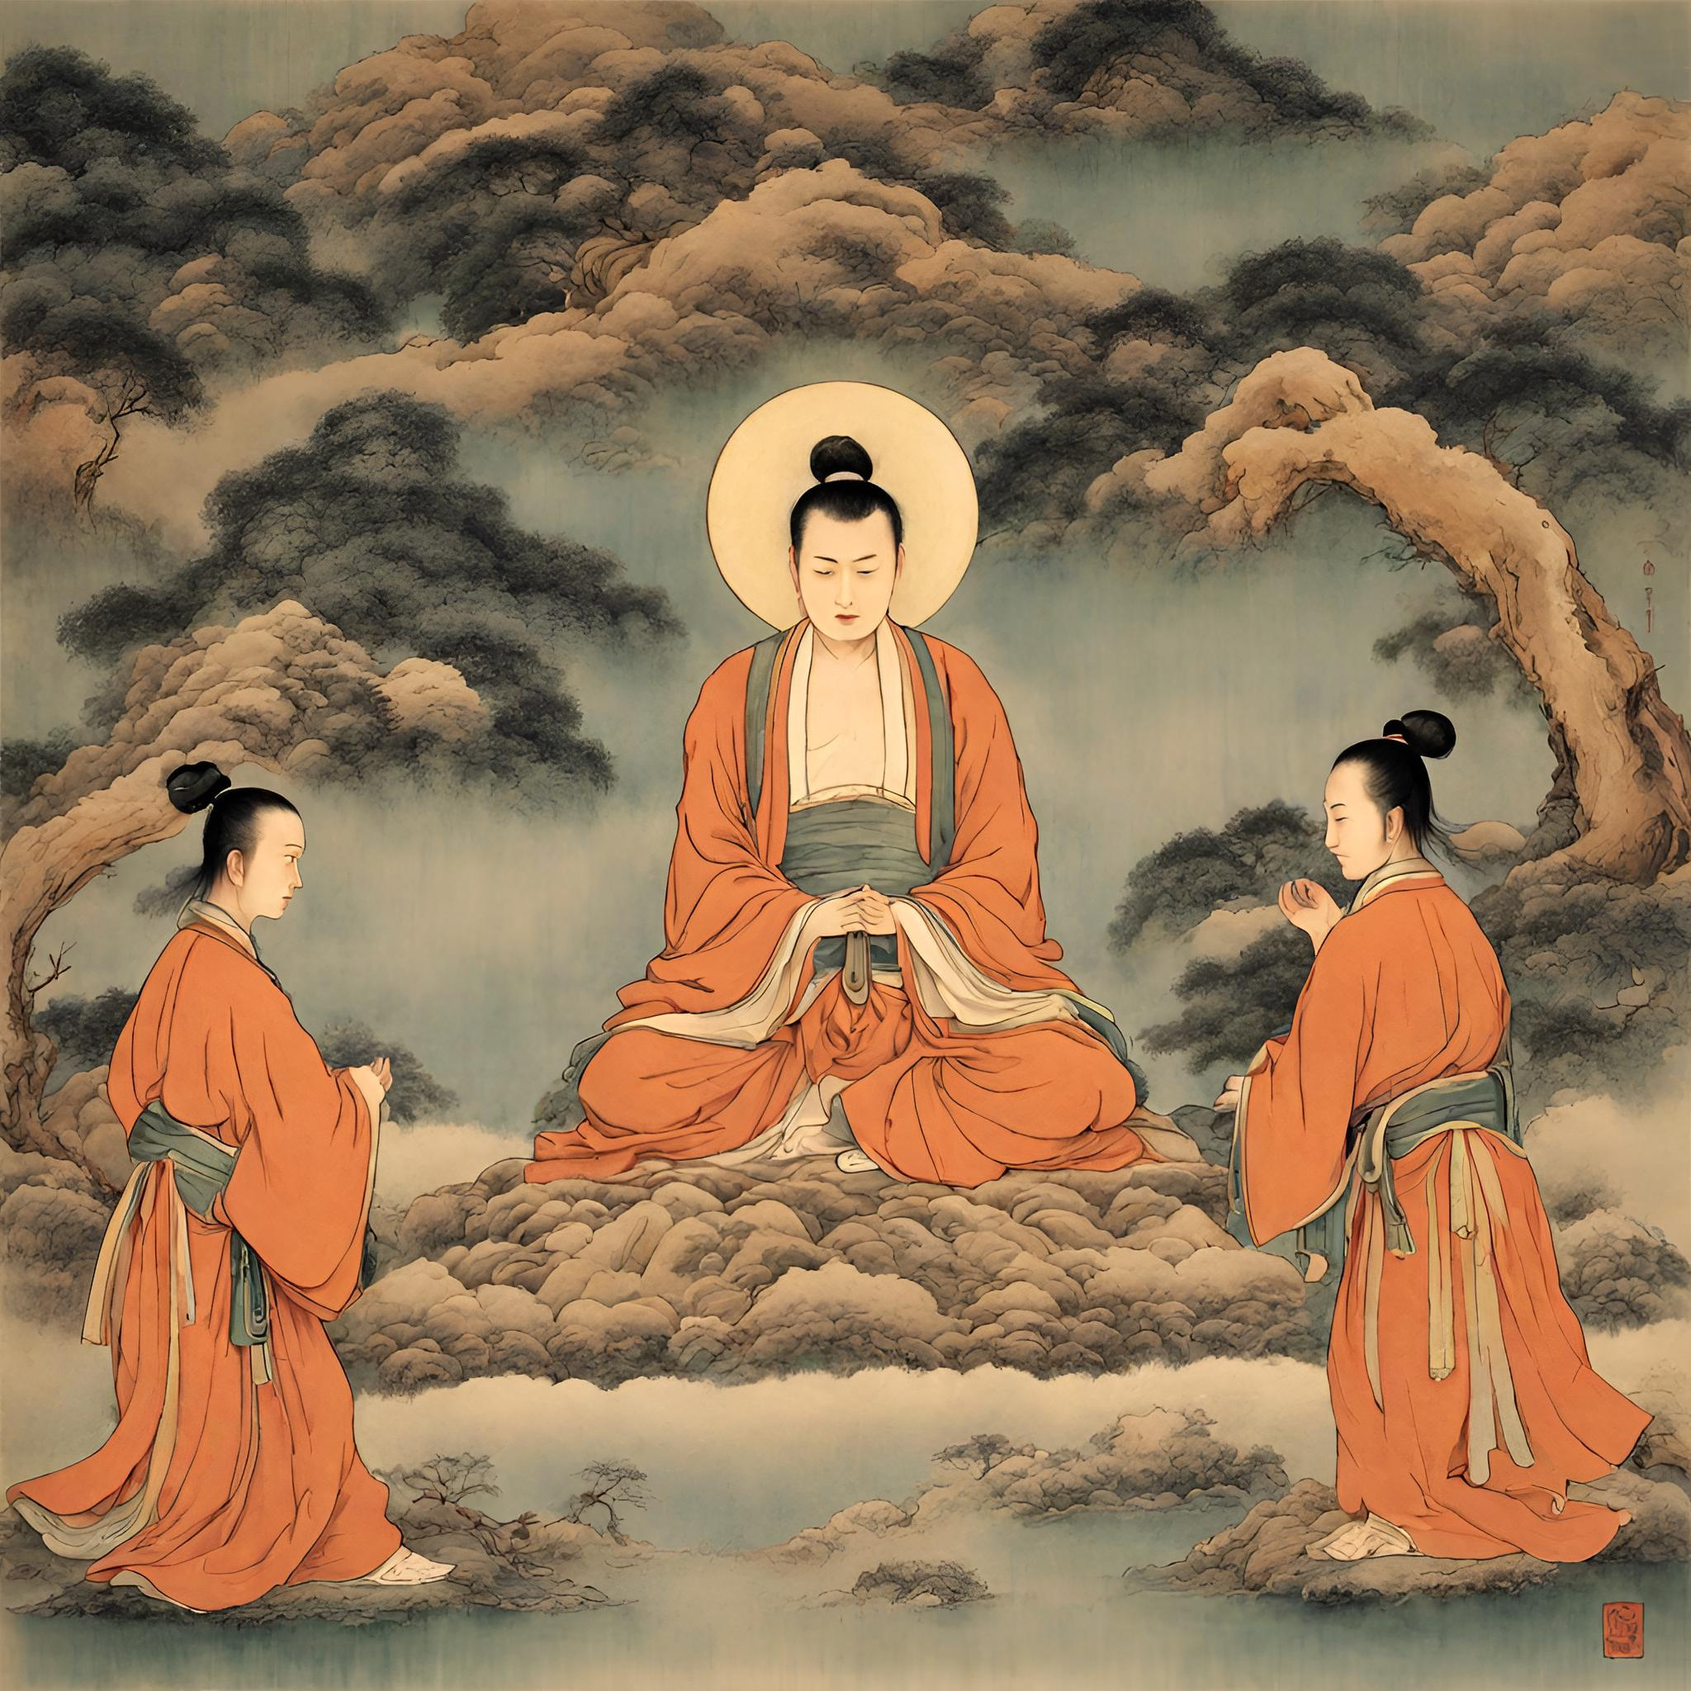
The concept of Dao or Tao
The Tao is not a Thing, or a substance in the conventional sense of its essence. It is invisible, indistinct, universal, shapeless and indefinable, in other words it can be observed in the world but we cannot perceive. Dao is also sometimes called as "mother" because she made and nourished all things. Dao is the origin of heaven and earth. It might be more helpful to regard Tao as a system of guidance.
Dao/Tao is not a God to be worshipped. Taoism does not include many deities. Although there are lots of Tacist temple, they are part of the universe and depend, like everything on Tao.

Slide 10
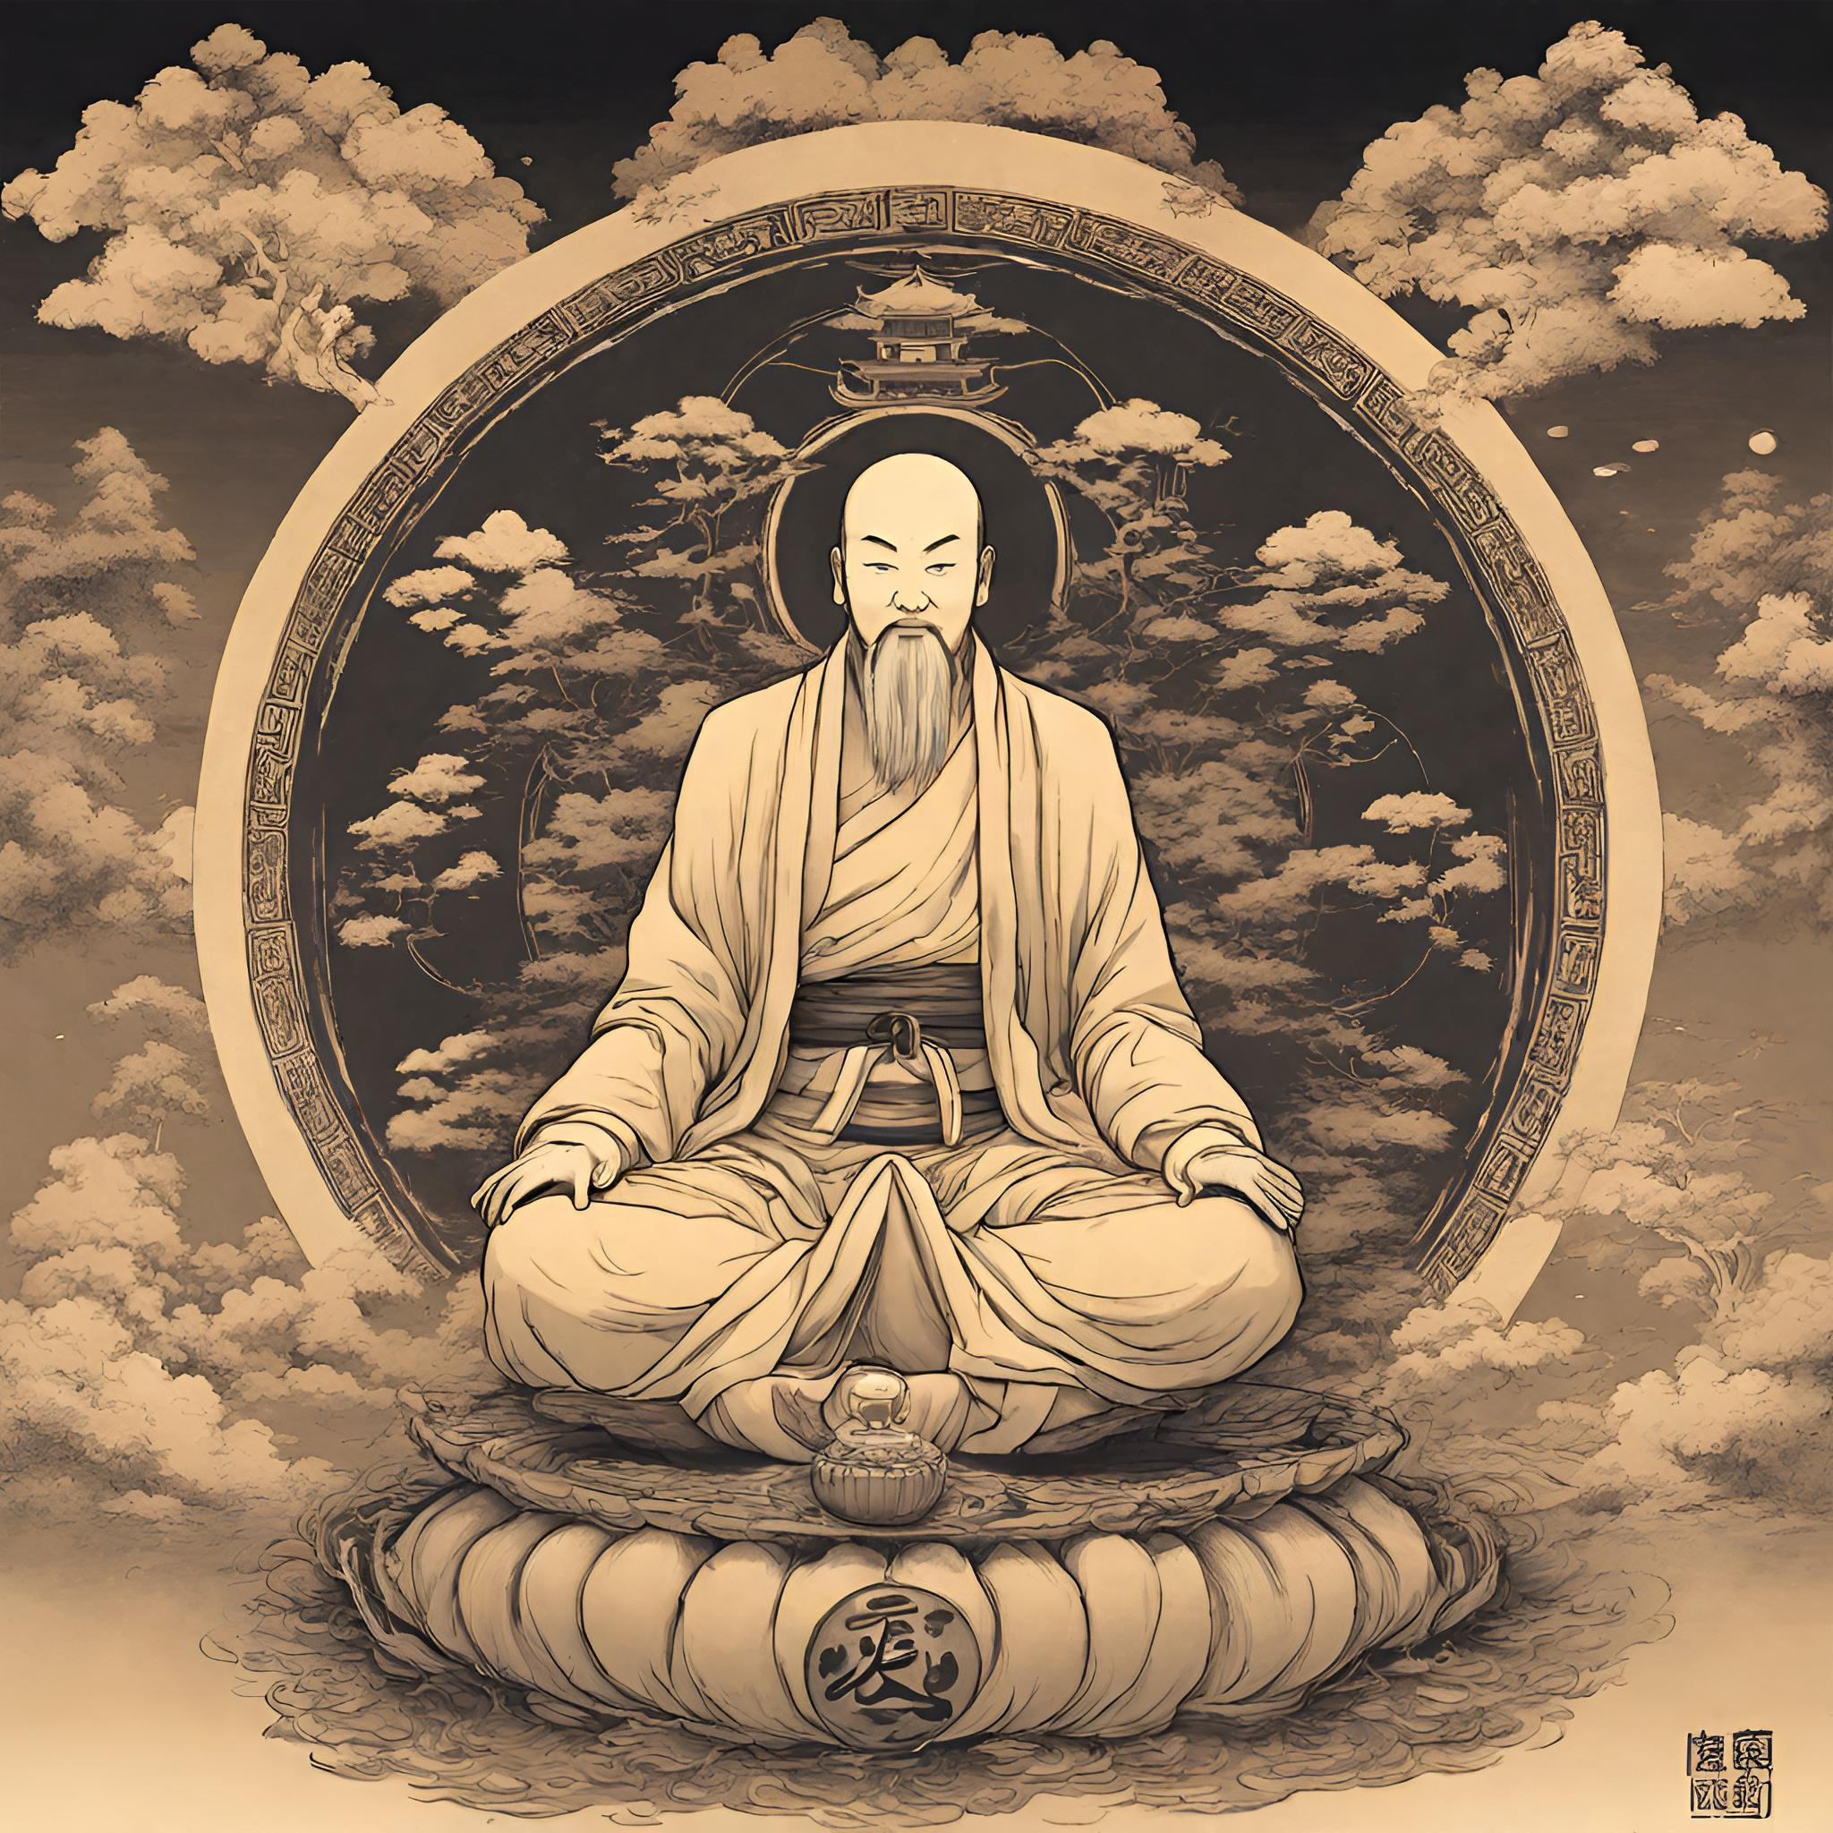
The concept of De
Usually translated as "virtual" also as an awareness of the Tao together with the capabilities that enable a person to follow the Tao. "Non-competition in Emptiness" is said to be the principle of "inaction in nature." Daoists believes that one person become peaceful if he/she do not have desire to compete to others. In line with this humility and contentment is the best way to great happiness. According to Laozi "There is no greater sin than the desire for possession, no greater curse than the lack of contentment.".

Slide 11
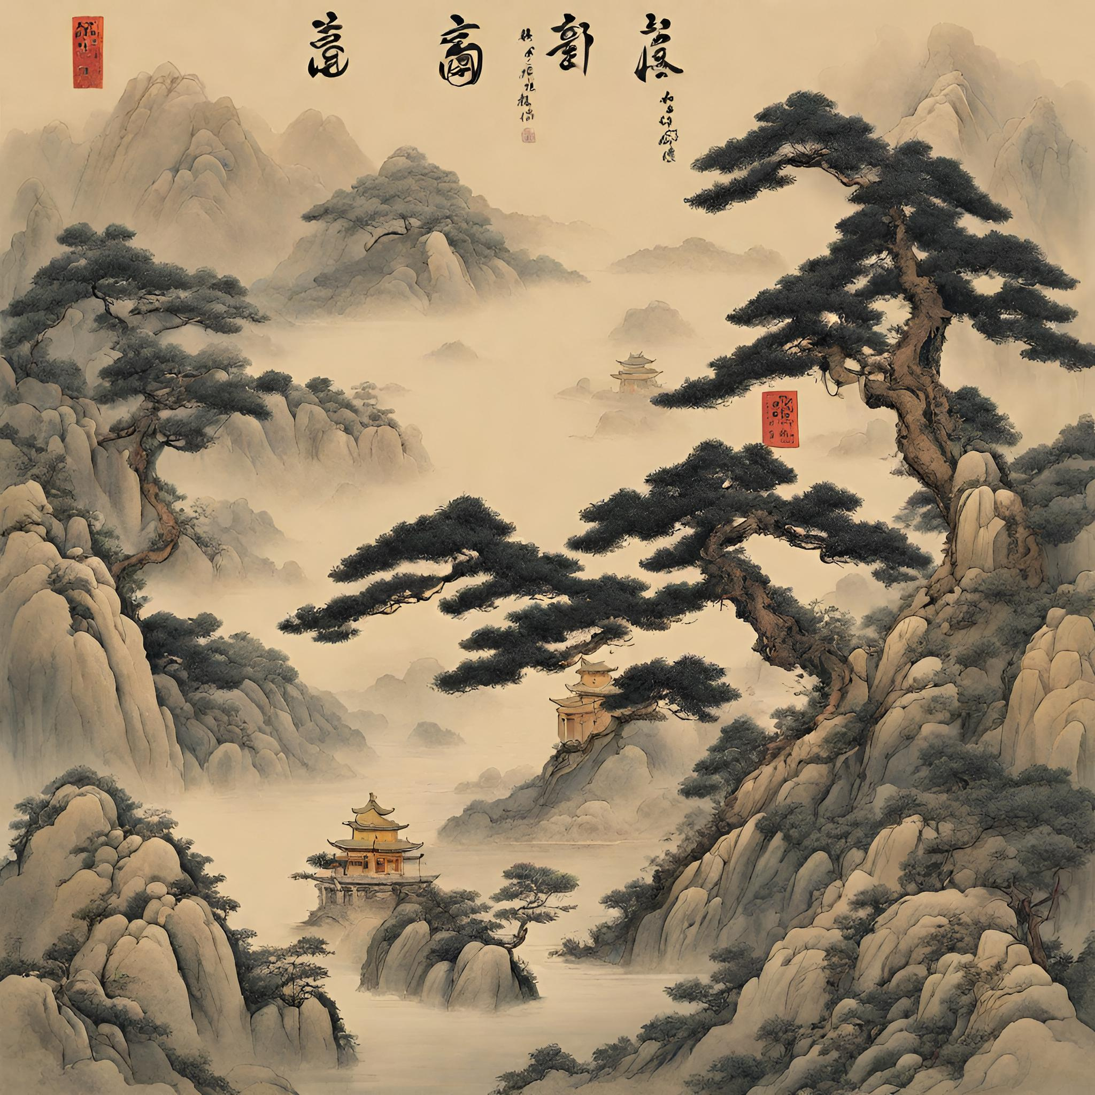
Wu Wei
Wu Wei is a central concept in Taoism. The practice and efficacy of Wu Wei are fundamental in Taoist thought. The literal meaning of Wu Wei is "without action", "no behavior", "doing nothing" or "action less activity". In ancient Taoist texts, Wu Wei is associated with water through its yielding nature. Taoist philosophy proposes that the universe works harmoniously according to its own ways. When someone exerts his will against the world, he disrupts that harmony. It advocates the goal of "go with the flow" attitude by cultivating a state of being wherein our actions are in harmony with the natural cycles of the universe.
.

Slide 12
Wu Wei
Non aggression is also important in wu wei, for Daoist, the ideal society is a primitive society with a natural, harmonious, and simple life which exists without competition and war (Ong, De Jose 2016). Becoming a hermit from society also another way of practicing wu wei by wandering through mountains, meditate in the caves, and eat based on what natural world has offer to them. This doesn't mean to stop a person living into a proactive life but their activities should fit into the natural pattern of the universe, and therefore need to be completely detached and disinterested and not ego-driven.

Slide 13
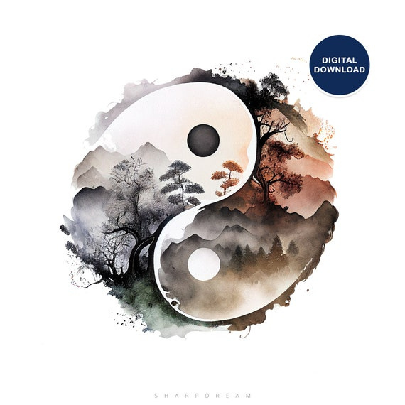
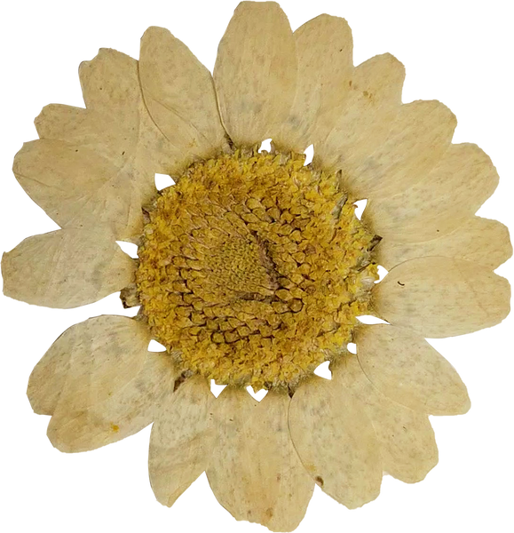
Yin Yang
Yin Yang is the principle of natural and complementary forces, patterns and things that depend on one another and do not make sense on their own. These may be masculine and feminine, but they could be darkness and light (which is closer to the original meaning of the dark and light sides of a hill), wet and dry or action and inaction. These are opposites that fit together seamlessly and work in perfect harmony. You can see this by looking at the yin yang symbol.

Slide 14
Yin Yang
The yin yang concept is not the same as Western dualism, because the two opposites are not at war, but in harmony. This can be seen very clearly in the symbol: the dark area contains a spot of light, and vice versa, and the two opposites are intertwined and bound together within the unifying circle. Yin and yang are not static, the balance ebbs and flows between them this is implied in the flowing curve where they meet.

Slide 15
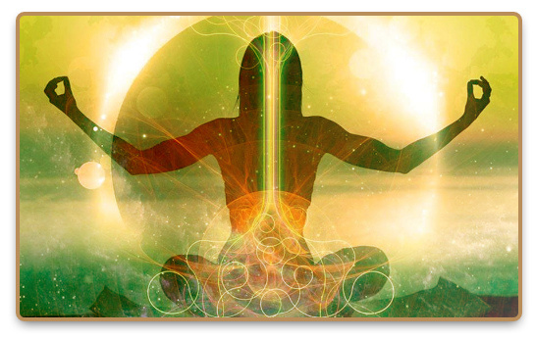
Qi/Chi
Chi or qi is the cosmic vital energy that enables beings to survive and links them to the universe as a whole. Qi is the basic material of all that exists. It animates life and furnishes functional power of events. Qi is the root of the human body; its quality and movement determine human health. Qi can be discussed in terms of quantity, since having more means stronger metabolic function. It is considered as the foundation of body and life.

Slide 16
Qi/Chi
Human life is the accumulation of qi; death is its dispersal. After receiving a core potential of primordial qi at birth, people throughout life need to sustain it. They do so by drawing postnatal qi into the body from air and food, as well as from other people through sexual, emotional, and social interaction. But they also lose qi through breathing bad air, overburdening their bodies with food and drink, and getting involved in negative emotions and excessive sexual or social interactions.

Slide 17


Unlike the Abrahamic religions, Daoism does not have a God, for Daoists believe that the universe originated from the Dao, which created and controls the universe and distantly guides things on their way. However, the Dao itself is not God and is not worshipped by the Daoists. Instead, they worship deities, who are gods of a particular role, and they traditionally worship Laozi not only as the first god of Daoism but also as the representation of the Dao. Most of the deities worshipped by the Daoists were borrowed from other cultures, but they are within the universe and are subject to the Dao. The Daoist pantheon has often been described as a divine administration which reflects the secular governments of Imperial China.
TAO AS THE ORIGIN OF ALL BEINGS

Slide 18
However, some believe that it is the other way around that the secular administrations are just reflections of the divine administration (Fairbank and Reischauer 1989). For the Daoists, the Dao possesses heavenly qualities, is mysterious, indescribable, lies under the surface of sense perception, and unifies obvious opposites on a different level. Daoists also believe that the Dao can only be found in silence since it is heavenly and beyond change. For the Daoists, God is found inside us, in the thoughtful emptiness from which all power and life originates in all directions; it is the "Nothing" within all of us where all our energy comes from.
TAO AS THE ORIGIN OF ALL BEINGS

Slide 19
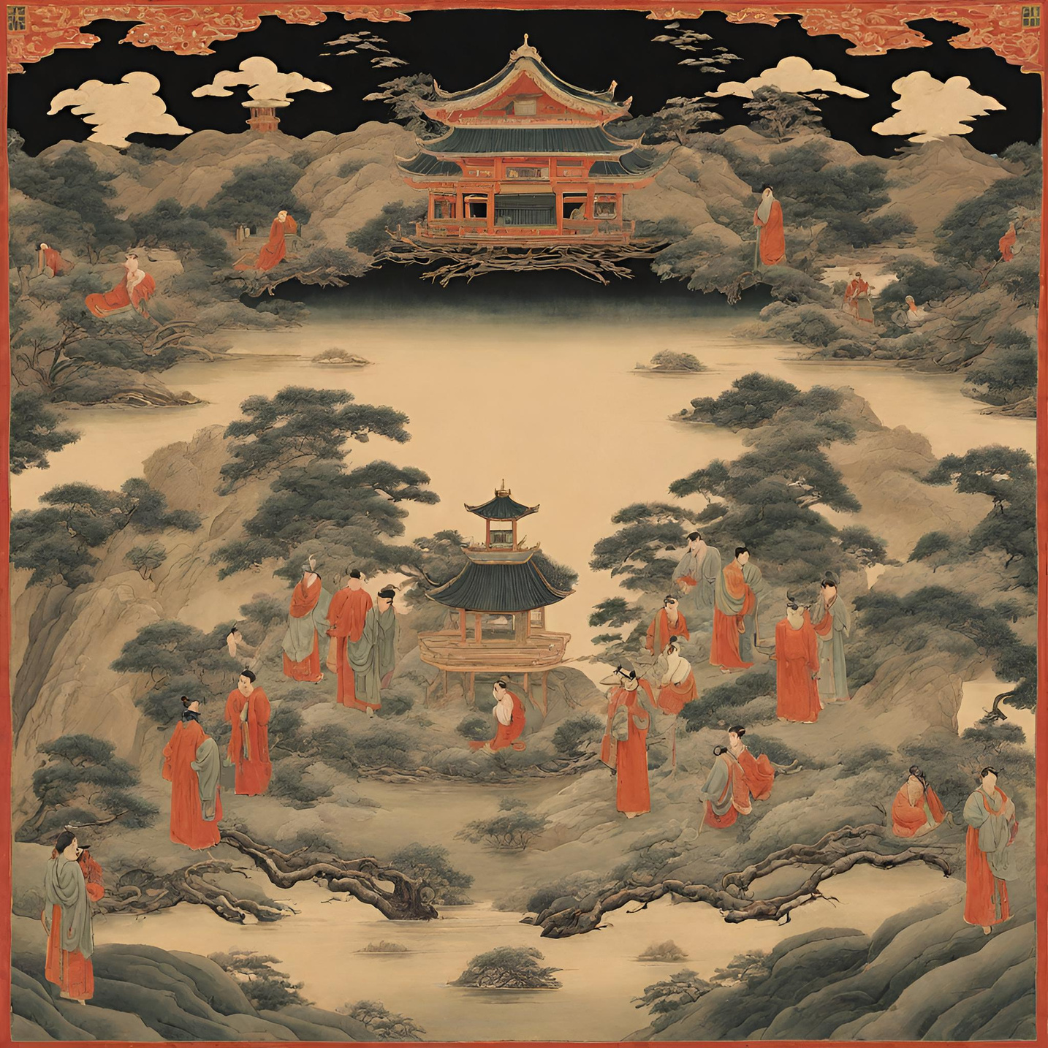
ISSUES

Slide 20
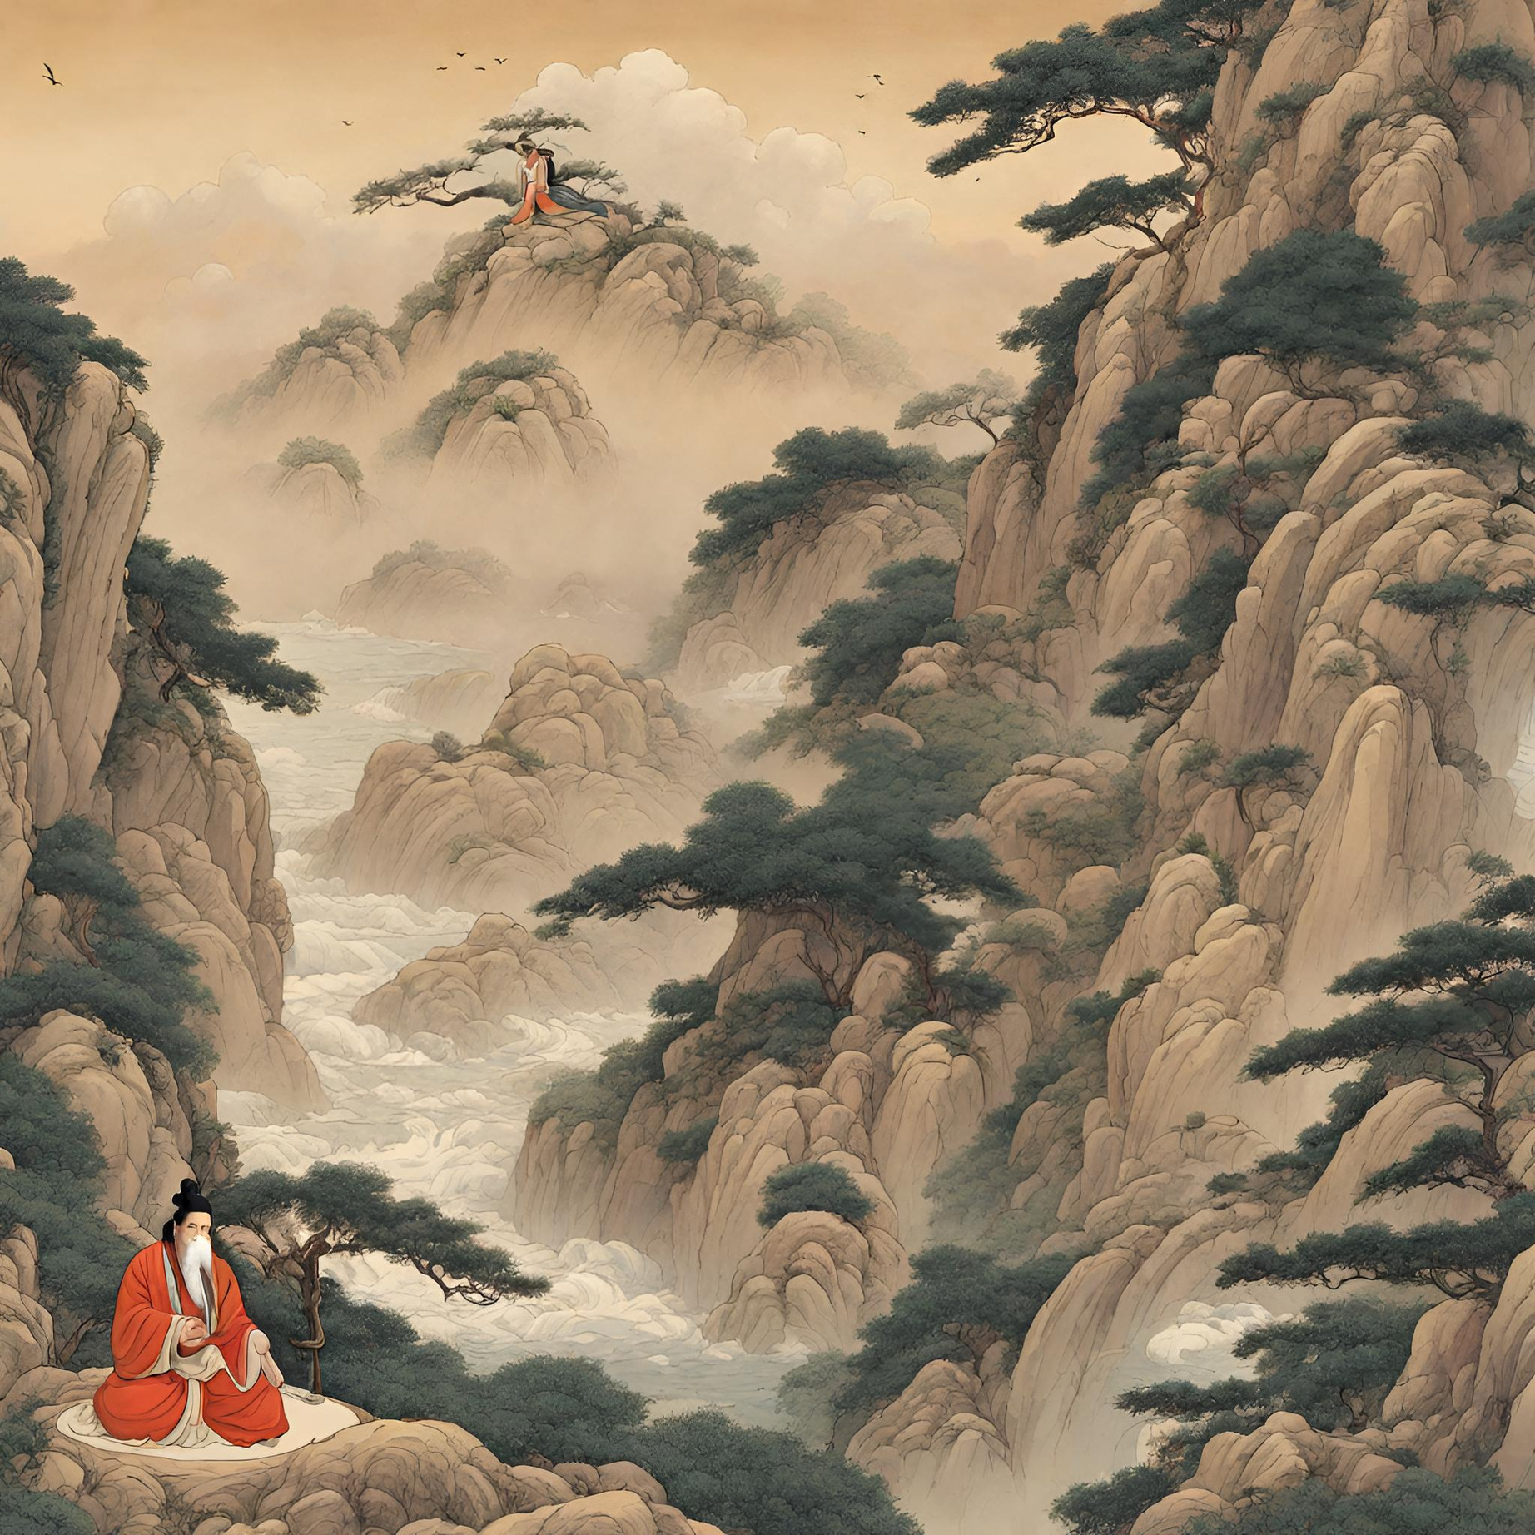
Inaction
Anyone who has left something up to fate knows that doing nothing is often the hardest course of action. Yet, according to the Taoist notion of Wu Wei, it is through this inaction that harmony is reached. Inaction often related in laziness or espousing a fatalistic attitude in life by letting nature take its course and reminding Daoists to just go with flow. In Taoism, inaction simply means avoiding unnatural action by not doing forced or aggressive action. It means performing all one's actions with natural and unforced attitude. Using of incense is a way of communicating to deities.

Slide 21
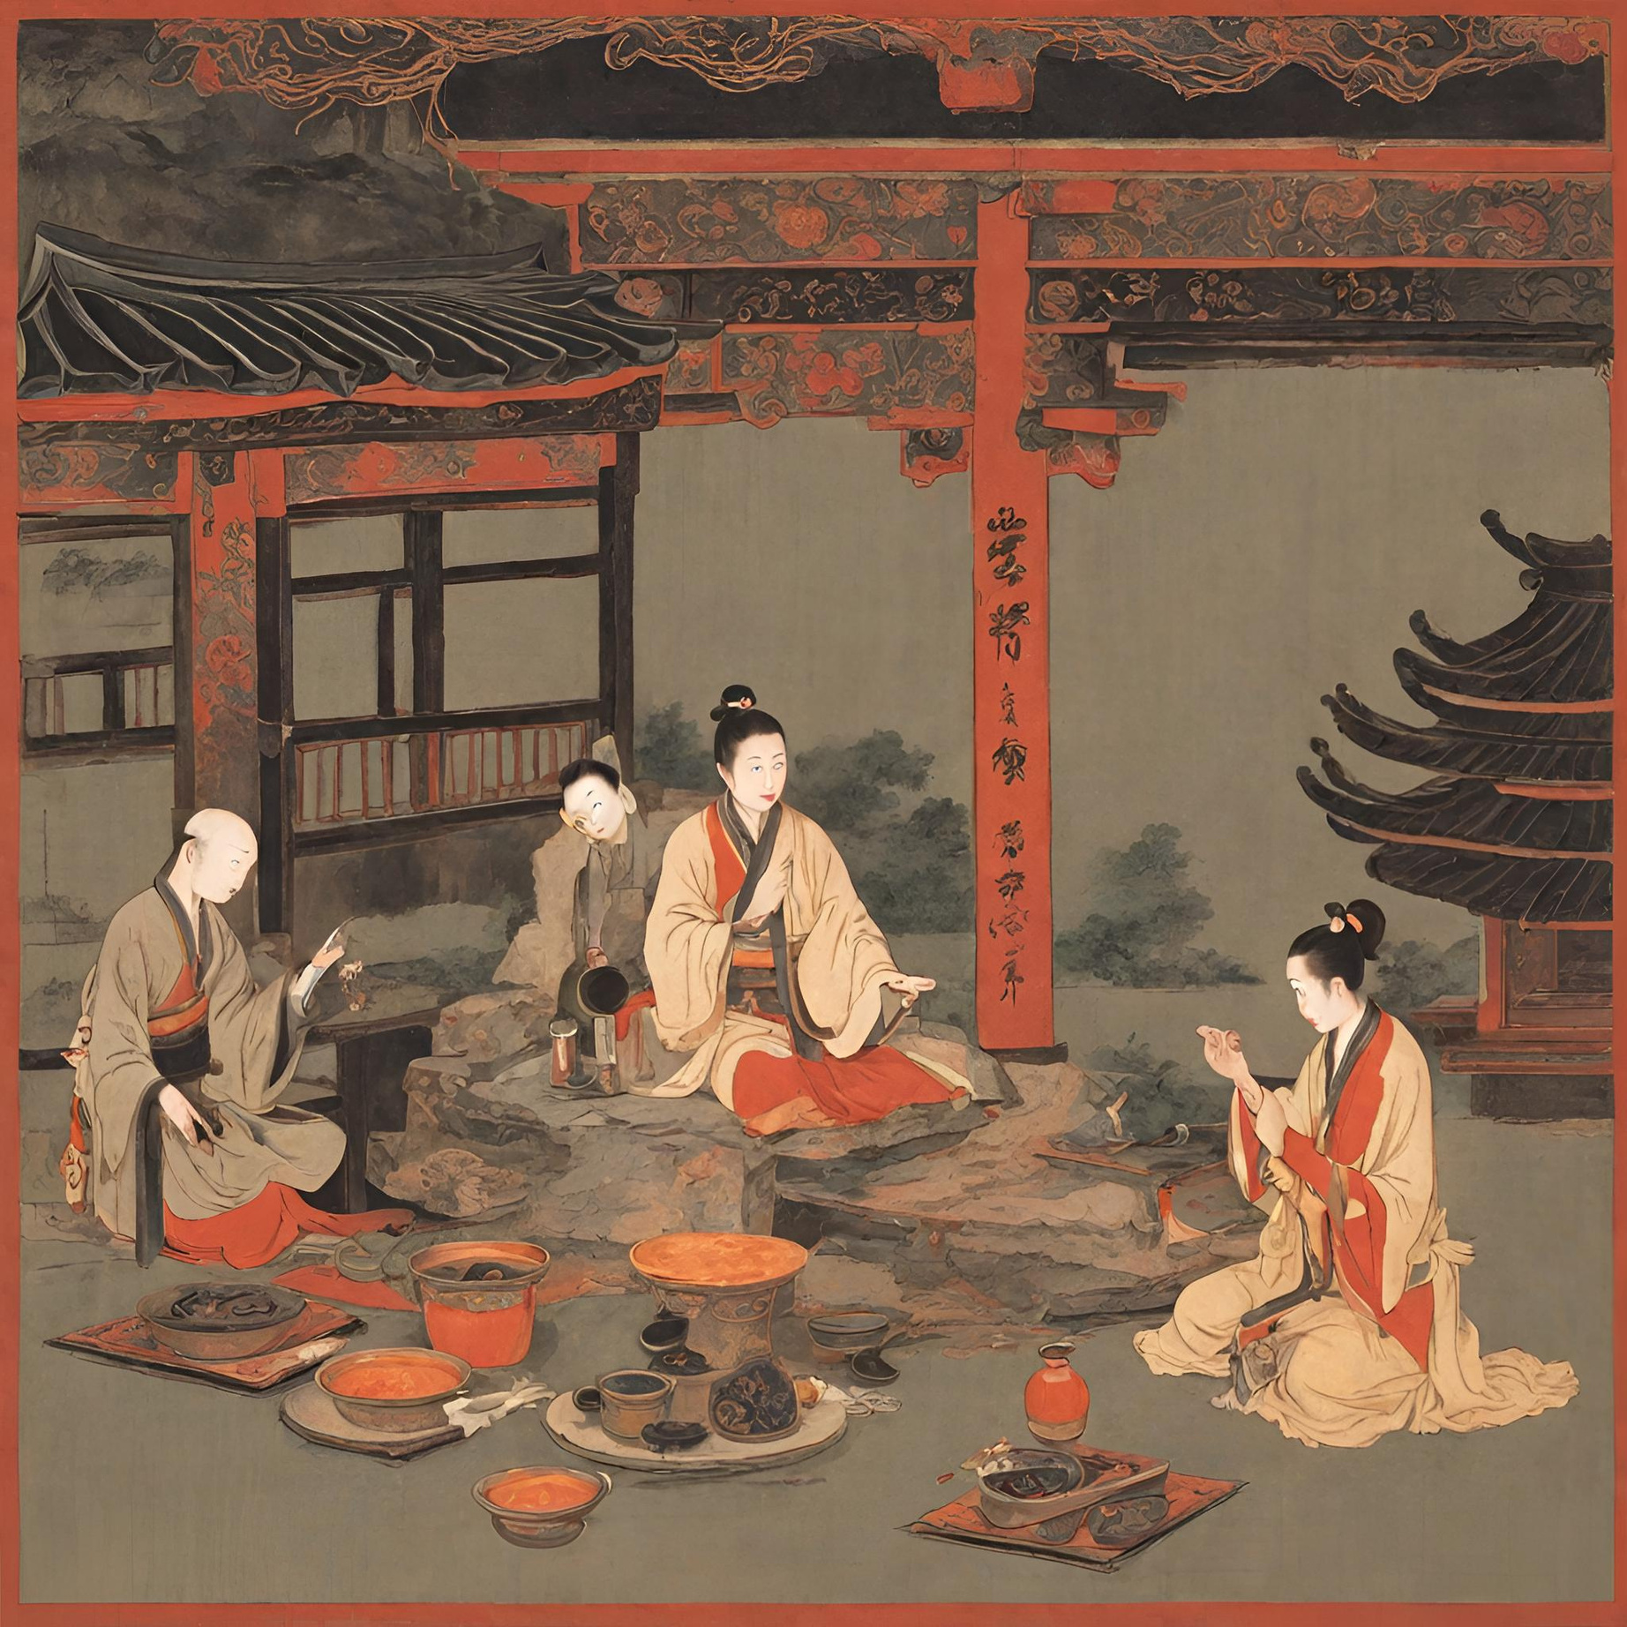
Superstitious Practices
Another issue encountered by Taoism is superstitious practices. There is a misconception that Taoism involves sorcery, this includes the drawing of signs, chants, and other practices which led to the notion it promotes superstitious practices. They believe that all things have spirits, and that deities of the heavens and earth are all around us. They guide us, protect, and bless us. In this way we should always show our gratitude to them by performing rituals such as praying and using incense as medium of communicating with their deities.

Slide 22
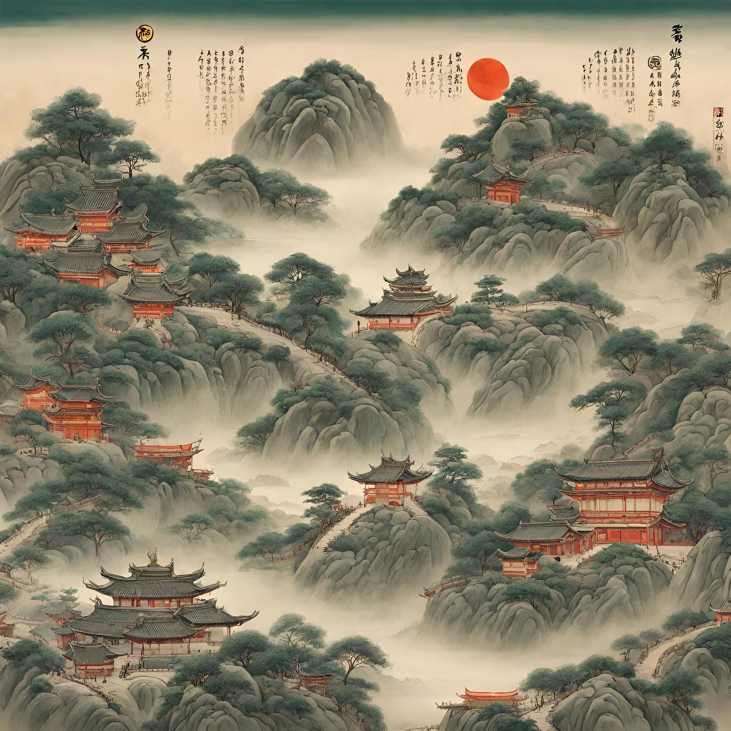
Environmentalism
Daoists believe in the dictum "leave nature alone, and nature will thrive." They advocate the utopian view of society characterized by order and harmony, and an emphasis on self-cultivation as means of achieving social harmony. One should have a healthy relationship with nature by taking care of one's body. Taoism stressed the balance of opposites and the interdependence of all things, which can be understood as an ancient equivalent of today's nation of the ecosystem. Excessive urbanization in China is being inconsistent in views of Taoism belief which is living in harmony with nature.

Slide 23
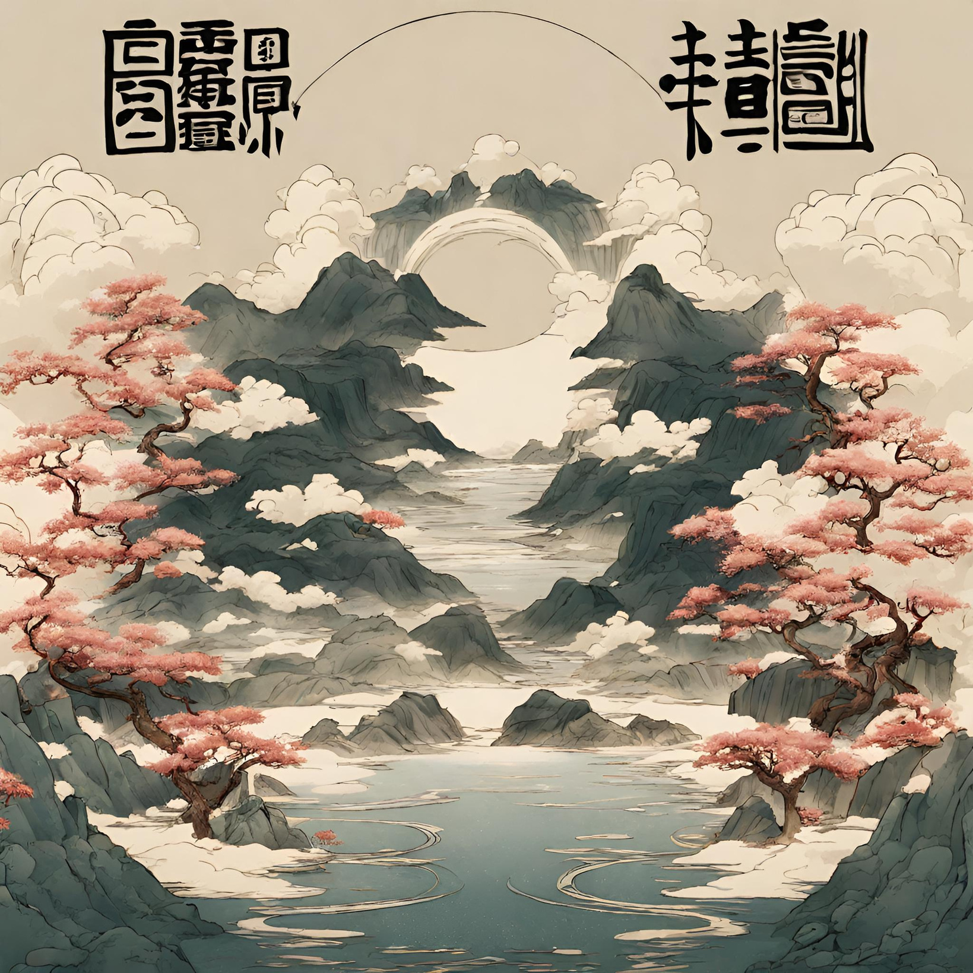
Thank
You

